Slide 1

Predicting College Attendance
Massachusetts Education System
By Wesley Rolfson

Slide 2
Massechusetts School System
The State of Massachusetts has recently begun work to improve the education in their state. They have started many new programs to help improve their attendance and test scores. Their plan is to improve the outcomes of their students (graduation, college attendance, college graduation, job placement) by the year 2025.
My project is aimed at providing information about the contributing factors for college attendance and to be able to predict the college attendance rates for schools.

Slide 3
The Data
Massachusetts has data for 1861 schools ranging from preschool-kindergarten, elementary, high-school and K-12 schools
They State recorded 302 different variables about each school including their demo graphics
For variables that represent a total quantity there is a corresponding variable that is the percentage as well
Data used for this project came from the repository on Kaggle posted by Nigel Dalziel. Data compiled from [Massachusetts Department of Education ]http://profiles.doe.mass.edu/state_report/)

Slide 4
Exploratory Data Analysis
1778 Schools are public schools
979 schools are Elementary
406 schools are middle school
386 are High School

Slide 5
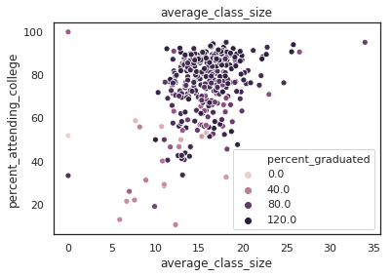
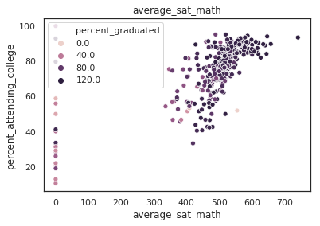
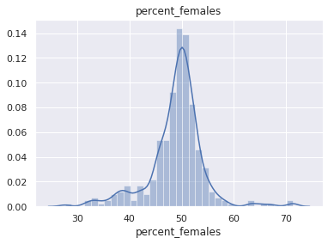
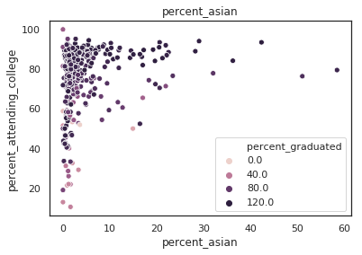
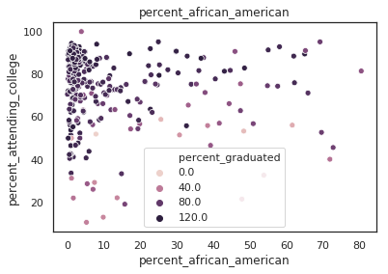
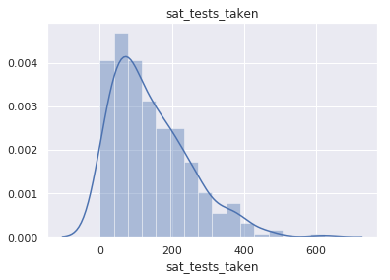
Statistics

Slide 6
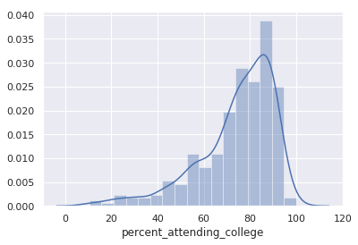
Statistics

Slide 7
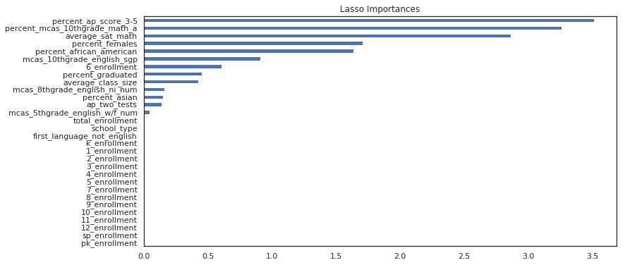
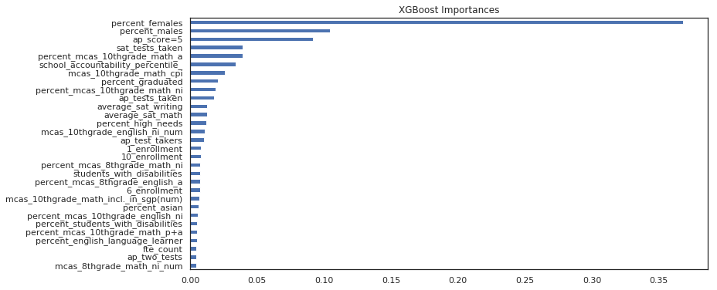
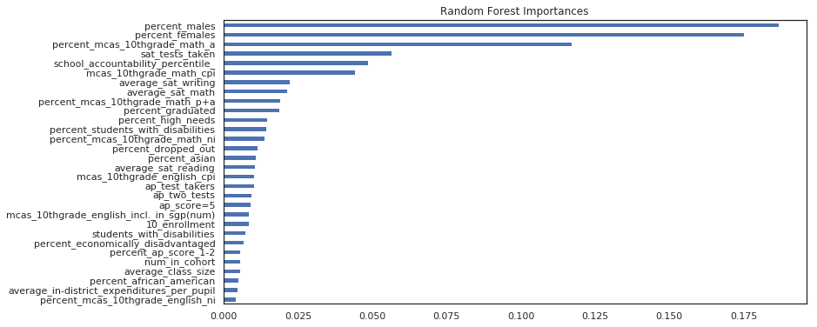
Feature Selection

Slide 8
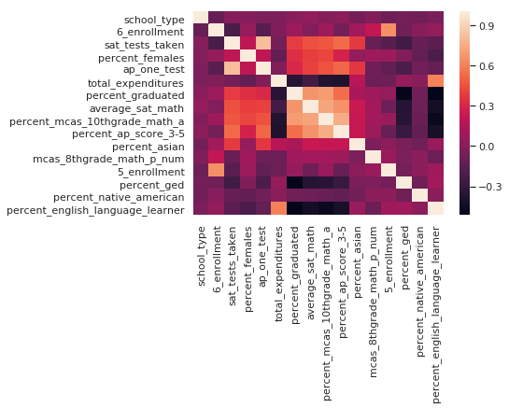
Feature Selection

Slide 9
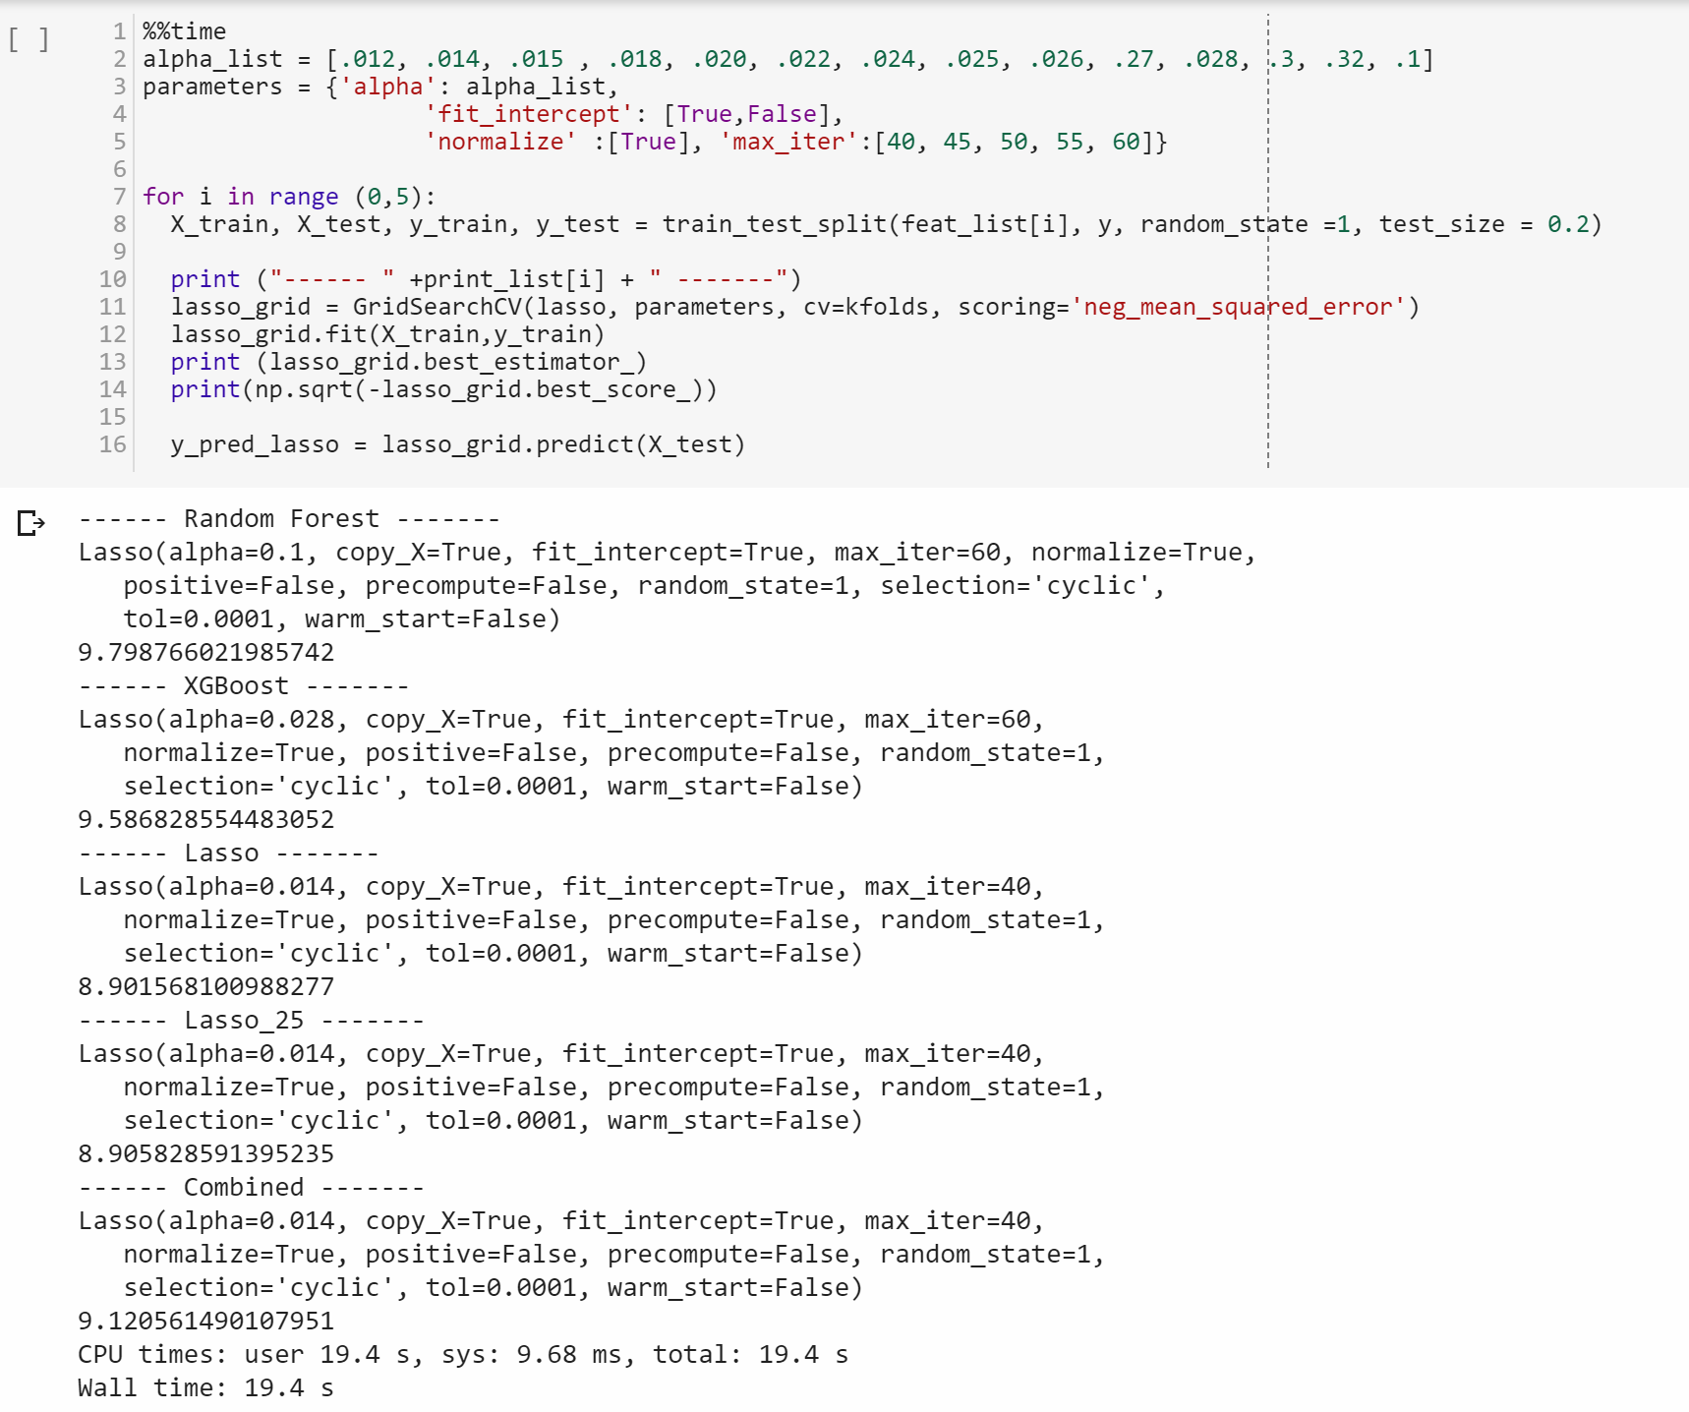
Prediction

Slide 10
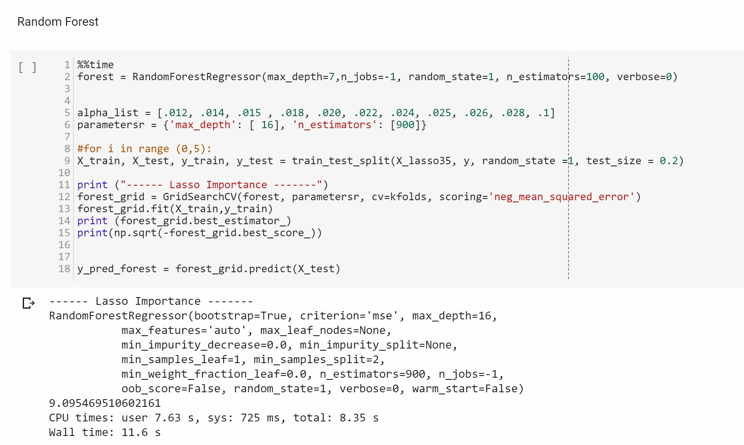
Prediction

Slide 11
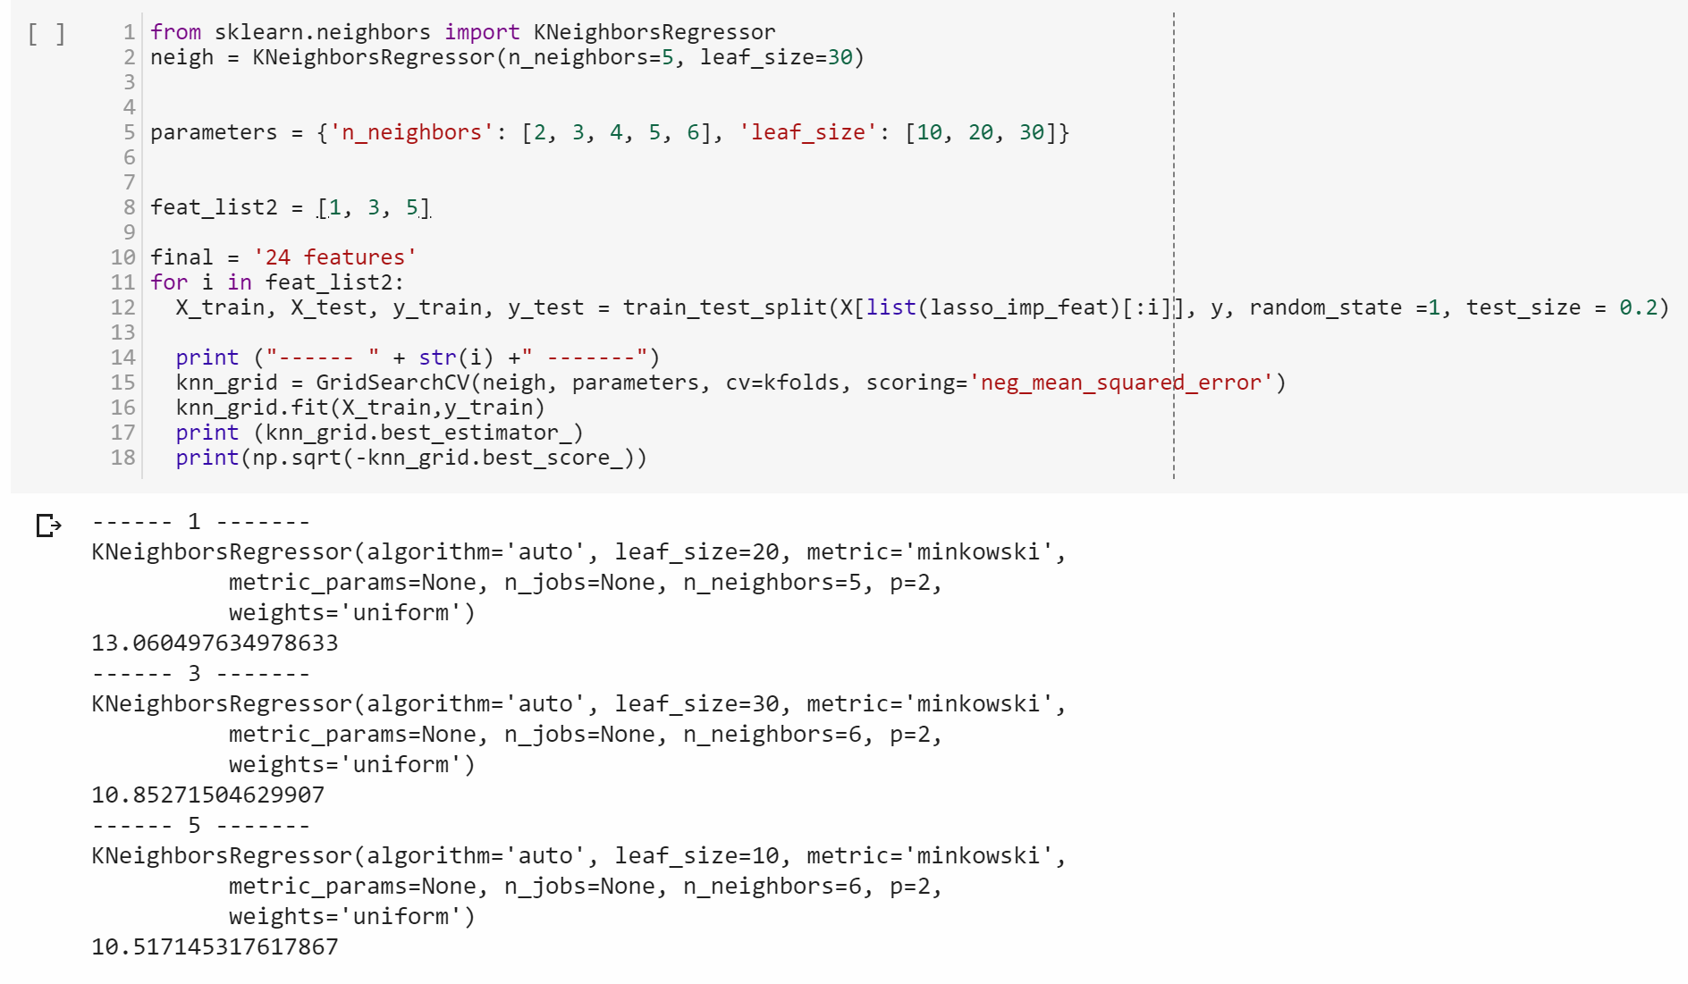
Prediction

Slide 12
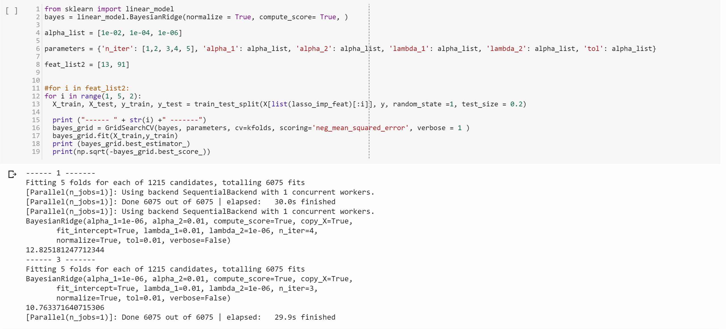
Prediction

Slide 13
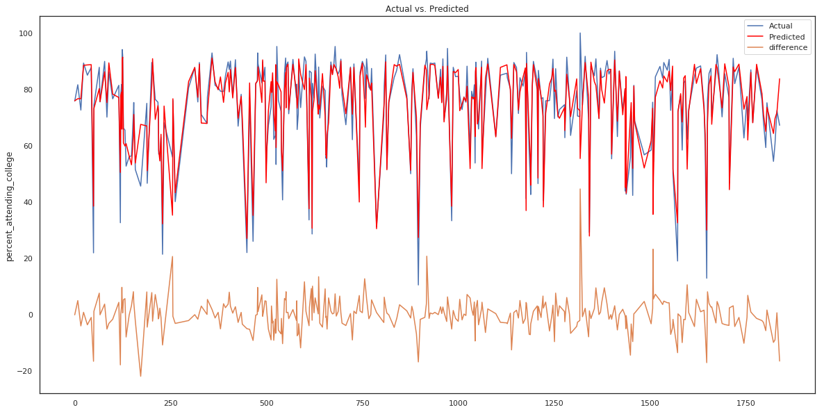
Prediction

Slide 14
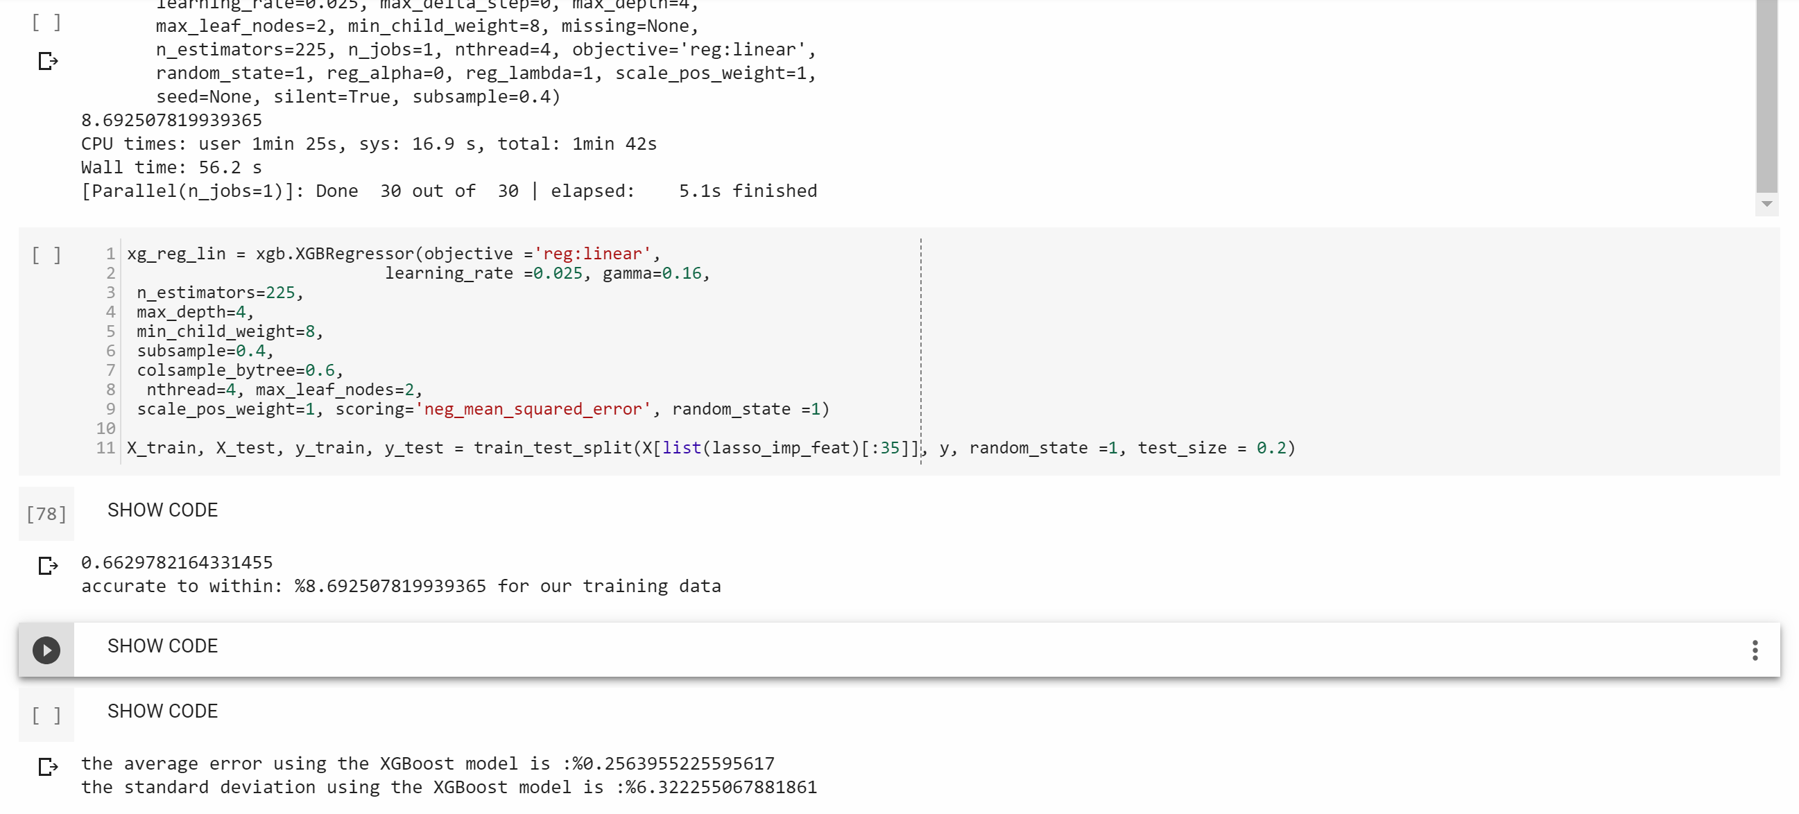
Prediction

Slide 15
Challenges
High variable correlation
Missing and incorrect entries
Variable names
Small number of entries in relation to variables
Inclusion of complete testing history

Slide 16
Improvements
To fully utilize the power of this predictive model I would want to gather all testing data
I would encorporate the participation of students and families in programs they are just now implementing
Consider using a neural network or clustering models to help id specific areas that we can target to improve the overall outcomes.

Slide 17
Conclusion
We can accurately predict college attendance
We can improve our model by improving our data collection
In the future our model could incorporate more advanced models

